Slide 1
Dear Customer,
Please take a few minutes to slide through and discover a number of new changes made in Portal

Slide 2
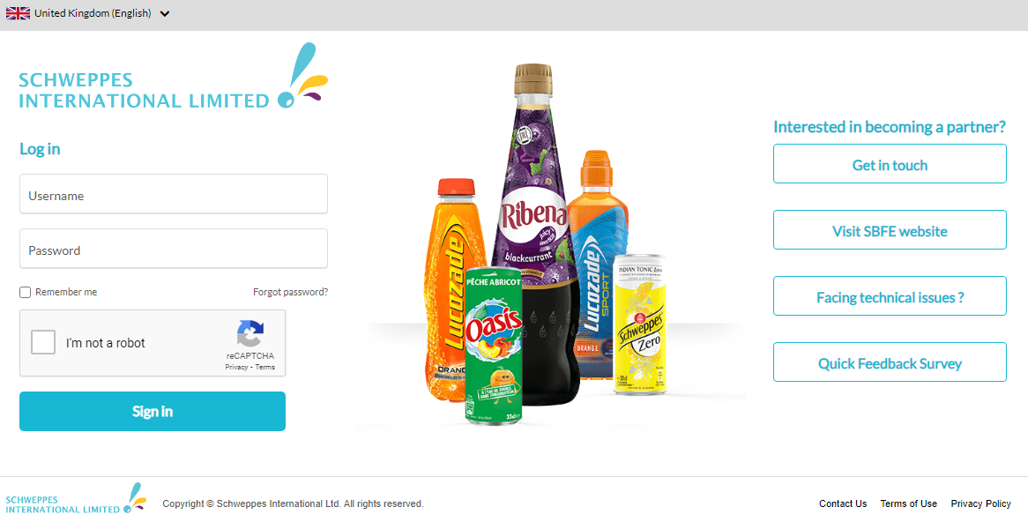
Click to Remember your Credentials
Click if you Forgot your Password
Report any Technical Issues
Captcha for Enhanced Security
Click to provide Feedback on Portal

Slide 3
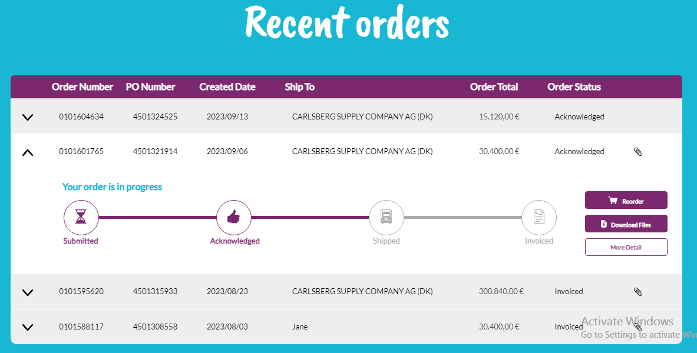
On this Page you can see your Recent Orders
Reorder
Download Order Documents
Go to Order Details

Slide 4
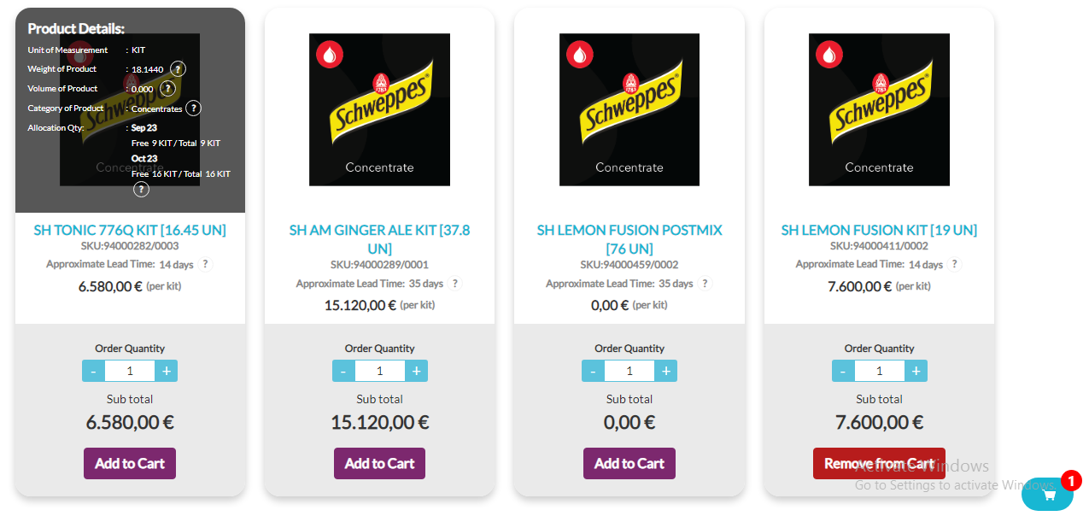
New Look of Products Page

Slide 5
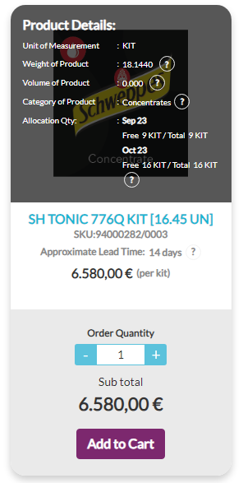
New way to Add Products to Cart
View of Product Details like Dimensions, Allocation Quantity, etc.
Lead Time
Adjust & add the Quantity you require to your Cart
Subtotal of the adjusted Quantity
Add Item to Cart

Slide 6
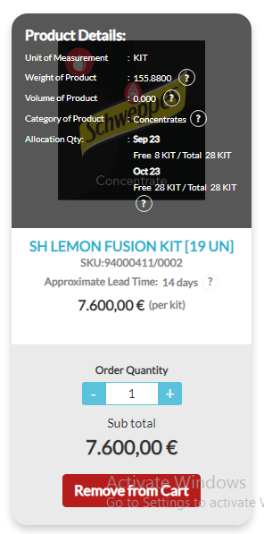
New way to Adjust Product Quantity in Cart
Adjusting the Quantity will adjust the Quantity of this item in Cart since it is already added to Cart
‘Remove from Cart’ indicates that you already have this Item in your Cart

Slide 7
New way to Remove Product from Cart
If you click on “Remove from Cart” It will remove the Item from your Cart

Slide 8
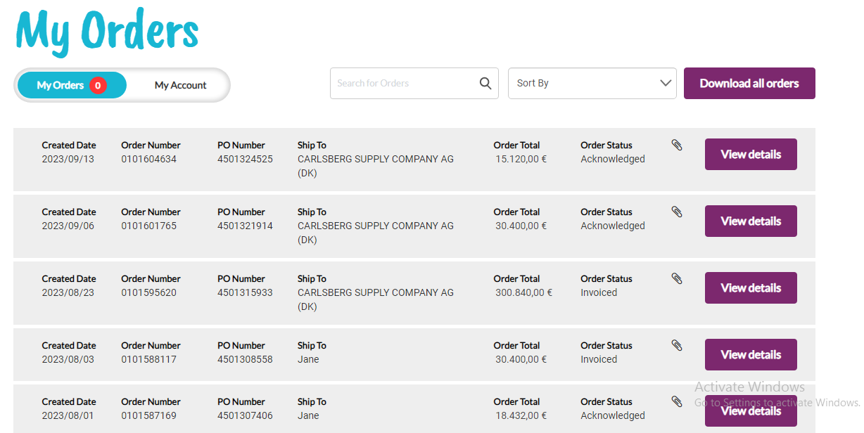
Search for any Order
Sort Orders
Download all Orders into an Excel Sheet
Number of Orders yet to be Viewed
See Order Details

Slide 9
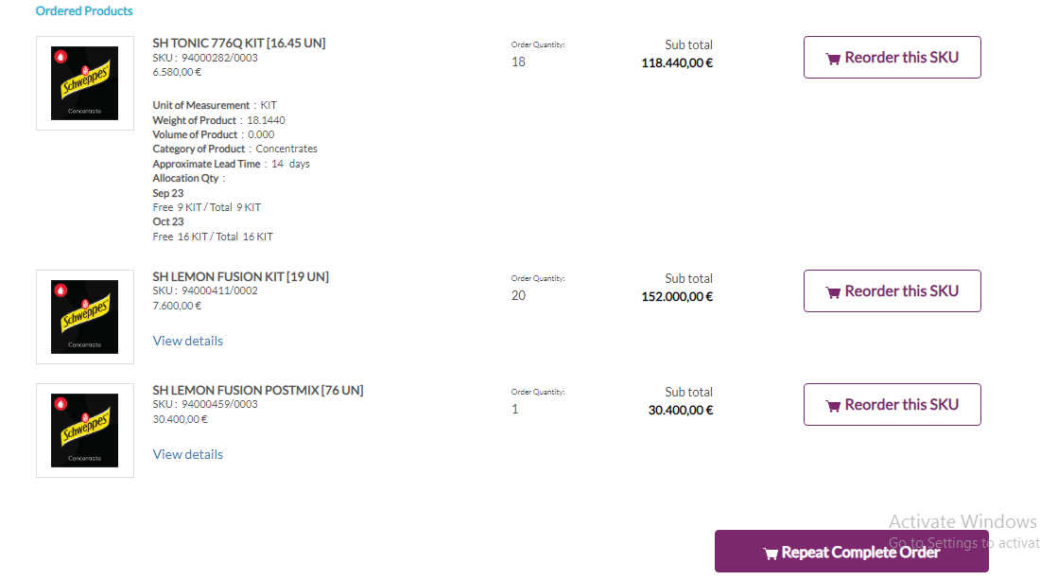
New way to add Products from Order Details Page
Details of product
Click to add previously Ordered Quantity of this SKU to Cart
View Details of product
Click to add all Ordered products with the above-mentioned Quantities to Cart

Slide 10
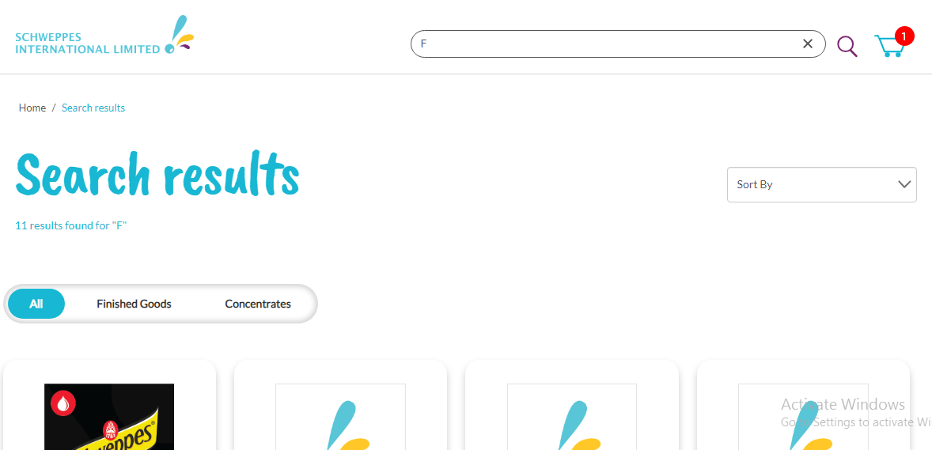
Search for a Product using Search Bar

Slide 11
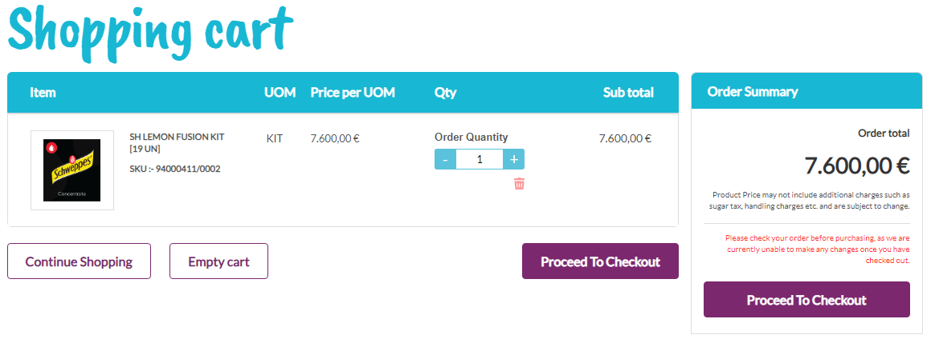
Order Total
Delete product from Cart
Adjust Quantity of Product in Cart
Remove all Items from Cart
Proceed to Checkout Page

Slide 12
Dear Customer,
If you wish to review this Tour again, you have the option to download it either from a link provided from the Home Page or from the last point in the FAQ Page.

